Slide 1
Parallelism

Slide 2
Parallelism
Benefit:
Allow the utilization of multi-core CPU
Bottle necks:
Context switching
Memory
Permanent storage

Slide 3
Process and threads

Slide 4
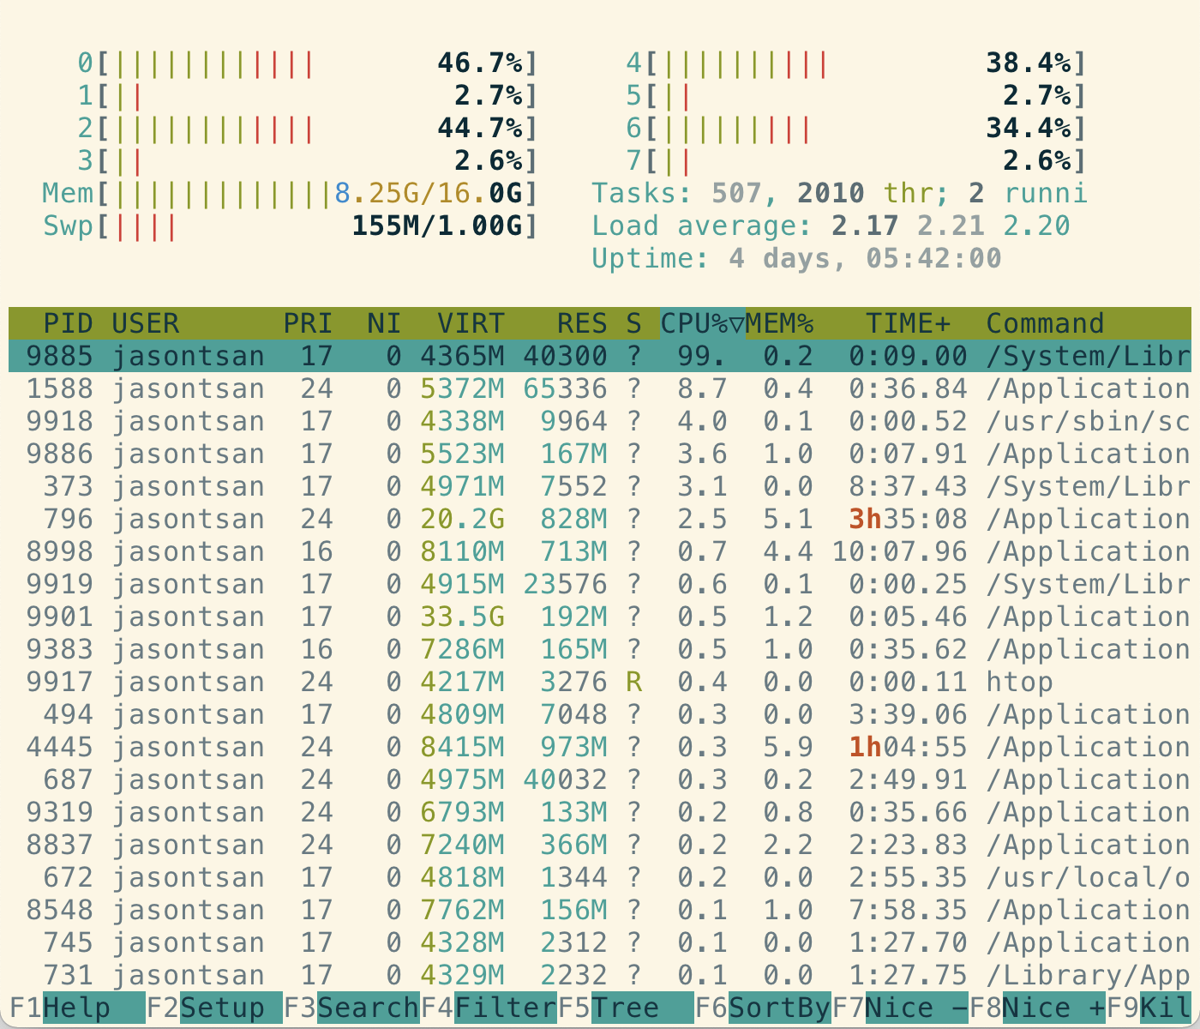
Process
OS level ownership
Has its own allocated memory
Heavy weight: Large overhead to create
Takes longer time for context-switch

Slide 5
Threads
Multiple threads can be attached to one process
Shared memory between threads
Need to ensure thread-safety
Easy to create
Takes shorter time for context-switch

Slide 6
Python’s GIL - Global Interpreter Lock
https://wiki.python.org/moin/GlobalInterpreterLock
In CPython, the global interpreter lock, or GIL, is a mutex that protects access to Python objects, preventing multiple threads from executing Python bytecodes at once. The GIL prevents race conditions and ensures thread safety.
Conclusion:
Multithreading is possible in Python, but only one thread is running at a time.
Solution: Use multiprocessing instead of multithreading

